Slide 1
Employee Data Analysis using Excel
STUDENT NAME: DIVYA.S
REGISTER NO. : 312216252 [ asunm1621312216252]
DEPARTMENT : BCOM ( general )
COLLEGE : Shri Shankarlal Sundarbai Shasun Jain College for Women

Slide 2
PROJECT TITLE
Data Analysis Using Excel

Slide 3
AGENDA
1.Problem Statement
2.Project Overview
3.End Users
4.Our Solution and Proposition
5.Dataset Description
6.Modelling Approach
7.Results and Discussion
8.Conclusion

Slide 4
PROBLEM STATEMENT
Organization’s sales data in Excel reveals inconsistent performance and lacks clarity on key factors influencing results. We need to analyse this data to uncover trends and patterns that affect sales. This analysis will not only drive organizational growth but also enhance individual skills in data management and analytical thinking. The goal is to use Excel to provide actionable insights that support both personal and organizational development.

Slide 5
PROJECT OVERVIEW
This project focuses on analysing our company's sales data using Excel to identify performance trends and key influencing factors. We will consolidate and clean data from multiple spreadsheets to ensure accuracy and consistency. Through exploratory data analysis and visualization, we aim to uncover actionable insights that can drive improvements in sales strategies. The project will produce clear charts and graphs to communicate findings effectively. Additionally, it will enhance personal skills in data analysis and contribute to organizational growth by informing better strategic decisions.

Slide 6
WHO ARE THE END USERS ?
1. Senior Management :
Executives:
Use Excel analyses to evaluate overall company performance, make strategic decisions, and set long-term goals. Insights help in understanding high-level trends and making data-driven decisions to steer the company in the right direction.
2. Sales and Marketing Teams:
Sales Managers:
Utilize data to track sales performance, identify successful strategies, and pinpoint areas needing improvement. This helps in setting realistic targets and optimizing sales tactics.
Marketing Professionals:
Analyze campaign effectiveness, customer demographics, and market trends to refine marketing strategies and allocate resources more effectively.
3. Finance Teams:
Accountants:
Apply data analysis for accurate financial reporting, expense tracking, and budgeting, ensuring financial integrity and compliance.

Slide 7
4. Operation system:
Operations Managers:
Analyze data to streamline processes, manage supply chains, and improve operational efficiency. Insights help in identifying inefficiencies and implementing cost-saving measures.
Logistics Coordinators:
Use data to optimize inventory levels, manage distribution, and reduce logistical costs.
5.Product and Service Managers:
Product Managers:
Leverage data to track product performance, understand customer preferences, and guide product development and strategy.
Service Managers:
Use analysis to monitor service quality, customer feedback, and operational performance to enhance service delivery.

Slide 8
OUR SOLUTION AND PROPOSITION:
SOLUTION OVERVIEW:
Power Query:
Power Query allows for sophisticated data extraction, transformation, and loading. (ETL). Users can connect to multiple data sources, apply transformations, and load data into Excel.
Dynamic Arrays:
Functions like FILTER(), SORT(), UNIQUE(), and SEQUENCE() in dynamic arrays simplify complex data manipulations and calculations.
Statistical Analysis and Forecasting:
Excel includes a range of statistical functions (AVERAGE(), MEDIAN(), STDEV(), CORREL()) and forecasting tools (e.g., FORECAST ETS).

Slide 9
VALUE PROPOSITION :
1. cost effective
2. User friendly interface
3. Flexibility and customization
4. Scalability
5. Improved decision making

Slide 10
DATASET DESCRIPTION
Employee dataset – Kaggle 26 Features
Employee ID - DE5B5E0E981696191474813EBC226A7F
Name – Text
Performance Level – Very High , High , Medium , Low
Gender – Male , Female
Employee Ratings

Slide 11
THE “ WOW” IN OUR SOLUTION
Performance level
IFS(Z8-5,"VERY HIGH" 28 -4,"HIGH",28>-3,"MED", TRUE, "LOW")

Slide 12
MODELLING
Data collection :
1). Department
2). Division
3). Job Function
4). Employee Classification
DATACLEANING:
1). Start date
2). End date
PERFORMANCE LEVEL:
1). Very high
2). High
3). Medium
4).Low

Slide 13
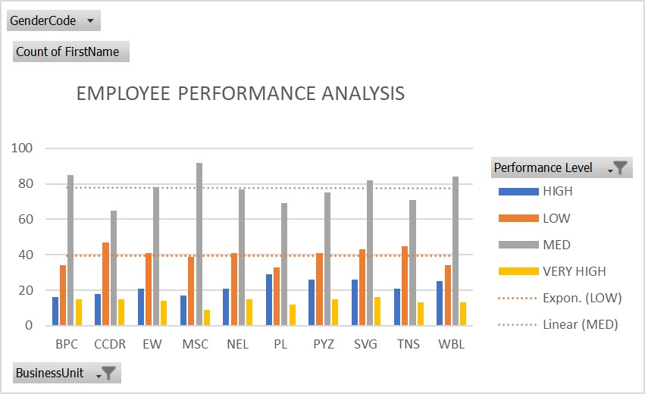
RESULT

Slide 14
CONCLUSION
In summary, a comprehensive conclusion for a data analysis in a research study involves a strategic synthesis of key finding of the performance level of an each employee specifically and their implications, contribution to the organisation as a brief .

